Slide 1

Overview of Bank Loan Trends

Slide 2
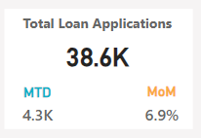
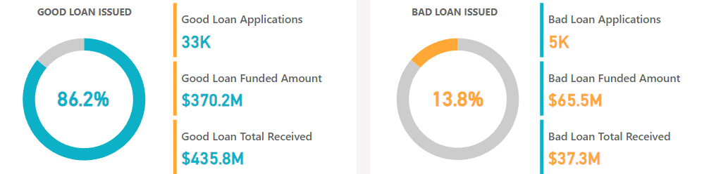
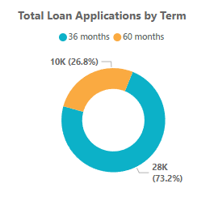
Loan Applications and Demand
Increase in Loan Applications
6.9% month-over-month increase in loan applications is seen, indicating a growing demand for loans. Month-to-date, there have been 4.3K loan applications, reflecting sustained demand.
Implications of Rising Demand
The rise in loan applications signals potential economic activity as individuals seek financial support. Understanding the reasons behind this surge can provide insights into consumer behavior and financial needs.
Popular Loan Terms
Loan terms of 36 and 60 months are the most preferred, suggesting a balance between manageable monthly payments and timely debt repayment.

Slide 3
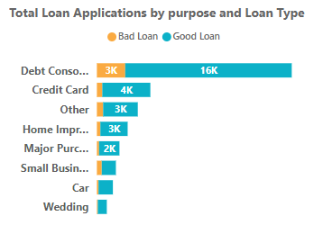
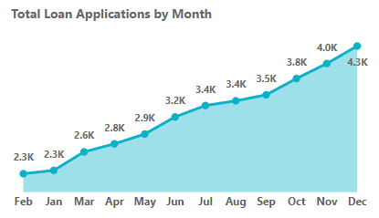
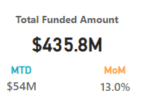
Funded Amount and Approval Trends
Popular Loan Purposes
Total Funded Amount Increase
Loan Approval Insights
The top three purposes for loan applications, including debt consolidation, credit cards, and home improvement, shed light on the financial challenges and aspirations of the borrowers.
The total funded amount has seen a significant 13% month-to-date increase, indicating either a rise in approved loans or larger loan amounts approved. This trend may signal the bank's confidence in borrowers' ability to repay.
Understanding the trends in loan approvals can provide valuable insights into the bank's risk assessment and its approach to meeting the financial needs of its clientele.

Slide 4
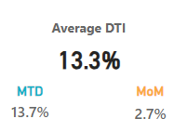
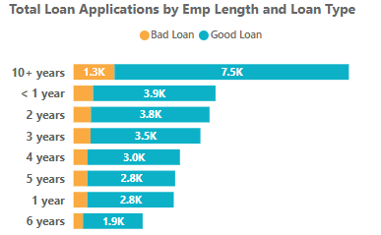
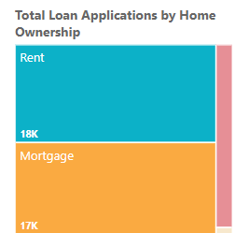
Borrower Financial Analysis
Debt-to-Income Ratio
The average debt-to-income (DTI) ratio, slightly up month-over-month at 2.7%, remains higher than the month-to-date average of 13.3%. A higher DTI ratio hints at borrowers potentially facing financial strain, necessitating a closer examination of their ability to manage debt.
Borrower Employment Insights
The data on the employment length of loan applicants imparts a critical understanding of borrowers' financial stability, indicating their need for financial support amidst periods of transition or unforeseen expenses.
Renter Loan Applications
The predominance of loan applications from renters highlights the financial needs of this demographic and provides insights into their preferences and requirements for accessing credit.

Slide 5
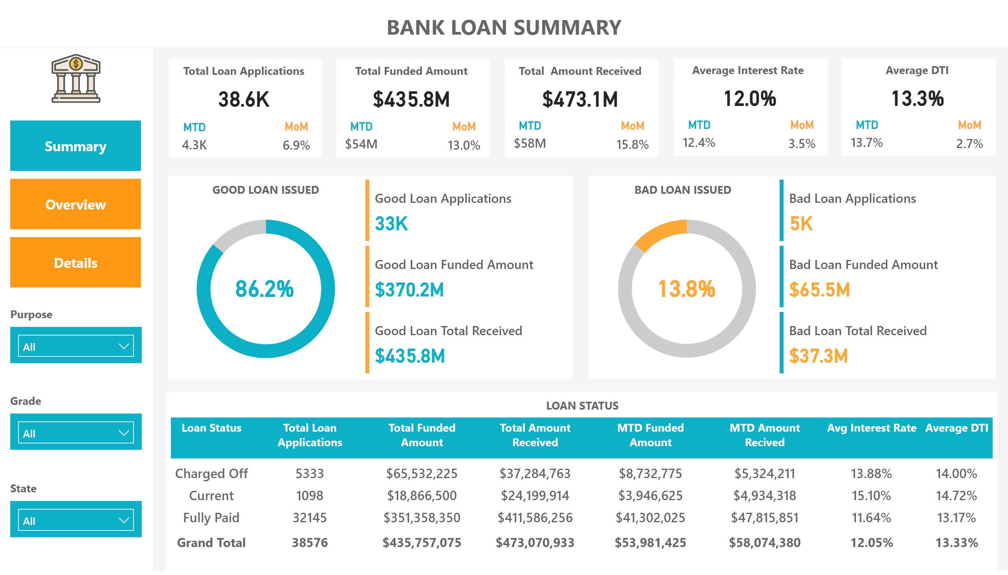
Summary
Notes:
shape
No alt text provided
textbox
No alt text provided
card
No alt text provided
MTD
No alt text provided
MoM
No alt text provided
shape
No alt text provided
textbox
No alt text provided
card
No alt text provided
MTD
No alt text provided
MoM
No alt text provided
shape
No alt text provided
textbox
No alt text provided
card
No alt text provided
MTD
No alt text provided
MoM
No alt text provided
shape
No alt text provided
textbox
No alt text provided
card
No alt text provided
MTD
No alt text provided
MoM
No alt text provided
shape
No alt text provided
textbox
No alt text provided
card
No alt text provided
MTD
No alt text provided
MoM
No alt text provided
shape
No alt text provided
card
No alt text provided
donutChart
No alt text provided
shape
No alt text provided
card
No alt text provided
donutChart
No alt text provided
shape
No alt text provided
shape
No alt text provided
cardVisual
No alt text provided
cardVisual
No alt text provided
shape
No alt text provided
tableEx
No alt text provided
shape
No alt text provided
shape
No alt text provided
slicer
No alt text provided
shape
No alt text provided
slicer
No alt text provided
shape
No alt text provided
slicer
No alt text provided
shape
No alt text provided
shape
No alt text provided
image
No alt text provided
pageNavigator
No alt text provided

Slide 6
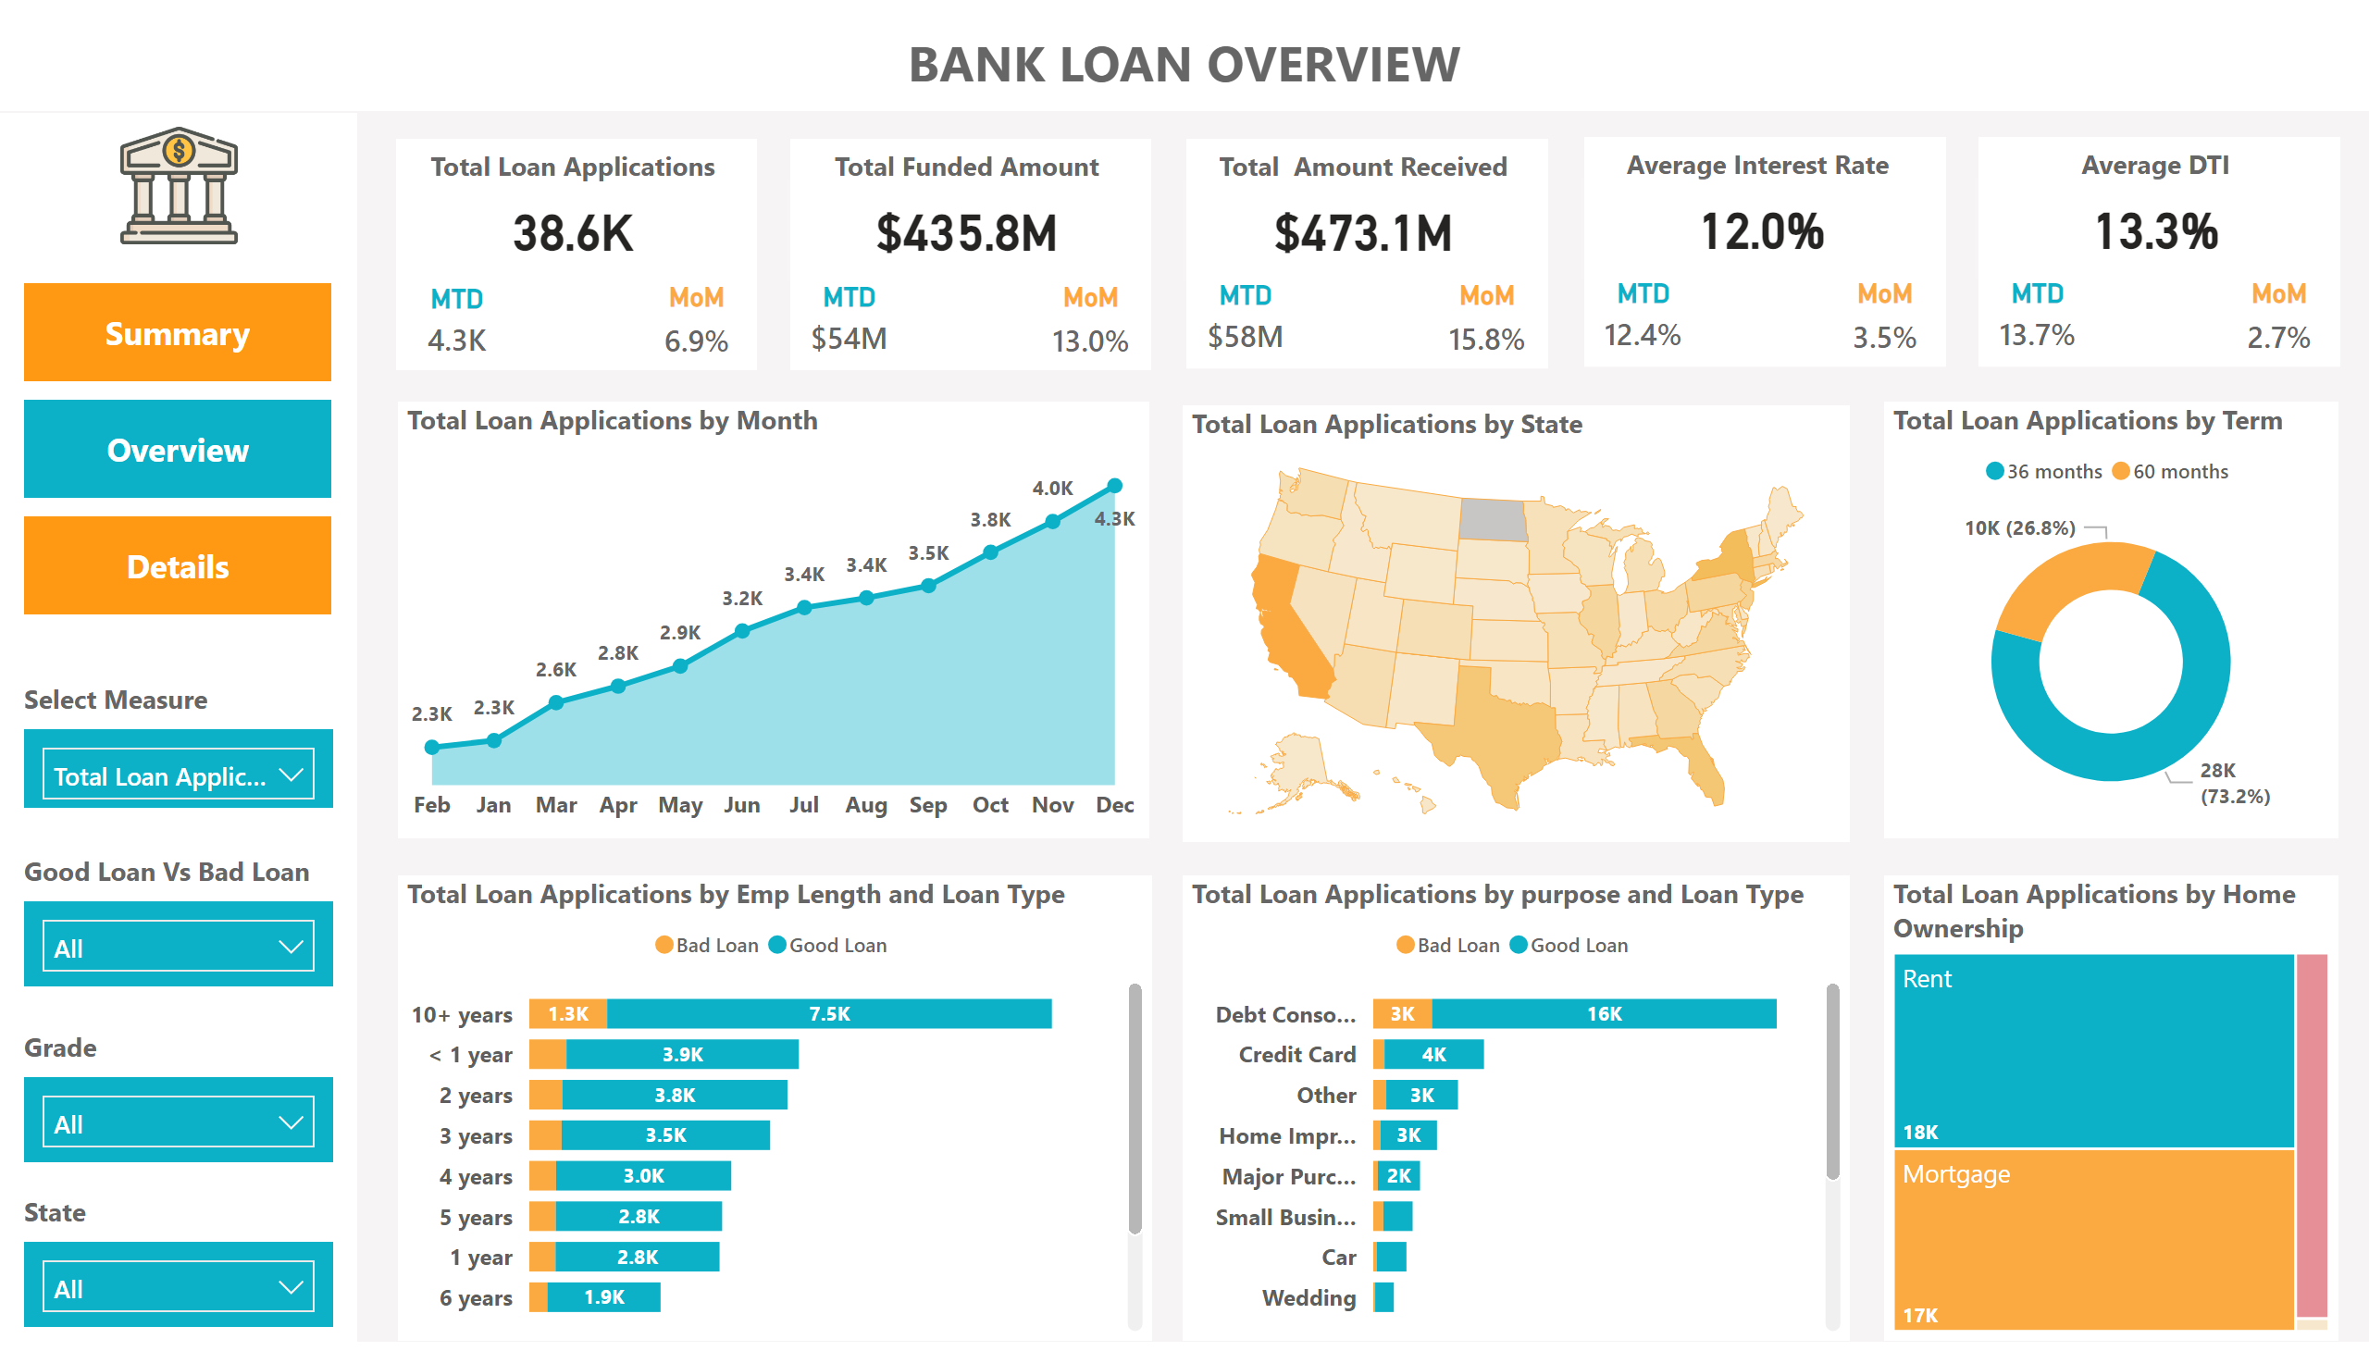
Overview
Notes:
shape
No alt text provided
textbox
No alt text provided
card
No alt text provided
MTD
No alt text provided
MoM
No alt text provided
shape
No alt text provided
textbox
No alt text provided
card
No alt text provided
MTD
No alt text provided
MoM
No alt text provided
shape
No alt text provided
textbox
No alt text provided
card
No alt text provided
MTD
No alt text provided
MoM
No alt text provided
shape
No alt text provided
textbox
No alt text provided
card
No alt text provided
MTD
No alt text provided
MoM
No alt text provided
shape
No alt text provided
textbox
No alt text provided
card
No alt text provided
MTD
No alt text provided
MoM
No alt text provided
shape
No alt text provided
slicer
No alt text provided
shape
No alt text provided
slicer
No alt text provided
shape
No alt text provided
slicer
No alt text provided
shape
No alt text provided
shape
No alt text provided
slicer
No alt text provided
shape
No alt text provided
areaChart
No alt text provided
shapeMap
No alt text provided
donutChart
No alt text provided
barChart
No alt text provided
barChart
No alt text provided
treemap
No alt text provided
image
No alt text provided
pageNavigator
No alt text provided

Slide 7
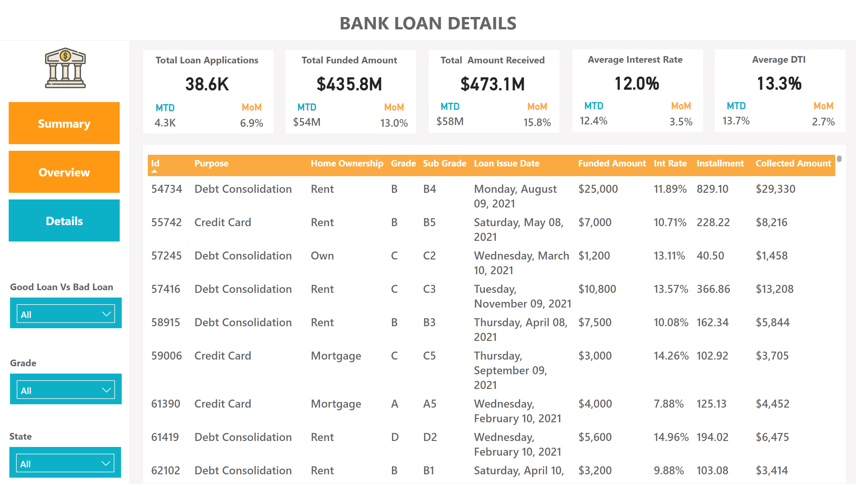
Details
Notes:
shape
No alt text provided
textbox
No alt text provided
card
No alt text provided
MTD
No alt text provided
MoM
No alt text provided
shape
No alt text provided
textbox
No alt text provided
card
No alt text provided
MTD
No alt text provided
MoM
No alt text provided
shape
No alt text provided
textbox
No alt text provided
card
No alt text provided
MTD
No alt text provided
MoM
No alt text provided
shape
No alt text provided
textbox
No alt text provided
card
No alt text provided
MTD
No alt text provided
MoM
No alt text provided
shape
No alt text provided
textbox
No alt text provided
card
No alt text provided
MTD
No alt text provided
MoM
No alt text provided
shape
No alt text provided
slicer
No alt text provided
shape
No alt text provided
slicer
No alt text provided
shape
No alt text provided
slicer
No alt text provided
shape
No alt text provided
shape
No alt text provided
tableEx
No alt text provided
shape
No alt text provided
image
No alt text provided
pageNavigator
No alt text provided

